Slide 1
General announcements
Homework:
Complete all the pre-lab questions on To Catch a Ball lab. You will lose points if you haven’t done this before walking in the door on lab day (I’ll be checking); if you have time after doing this, begin writing up the Tilted Table lab.
TO CATCH A BALL LAB:
Friday is the day of judgement…

Slide 2
To Catch a Ball Lab
On Friday, you will be executing the “To Catch a Ball Lab” procedure. This lab is EASY to do, but NOT SO EASY to prepare for. Basically, do the legwork BEFORE class!
The set up:
The ball moving at a determinable velocity rolls off a table of known height. Using your knowledge of kinematics and common sense, you and your partner need to calculate BEFOREHAND where a cup needs to be positioned on the floor to catch the ball.
You must present your prelab BEFORE testing. This is the list of equations and summary of measurements you will need to complete the task.
You will get a few minutes to take whatever data you need to calculate your predicted distance.
Then you get ONE shot to test your prediction (yes there is partial credit).
Your score on this lab will be determined by how close to the cup you come (hit it and you’ve got 20 points; be a cm or two off and you’ve got 19 points, etc.)

Slide 3
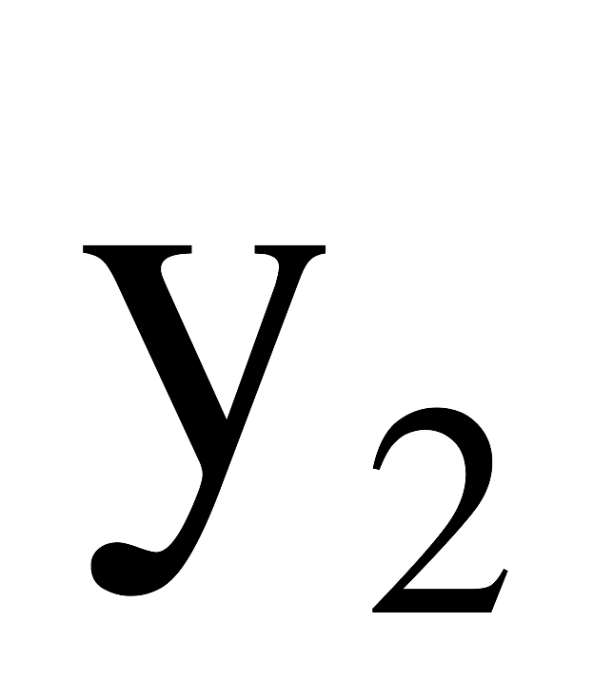
To Catch a Ball lab
table
cup
floor

Slide 4
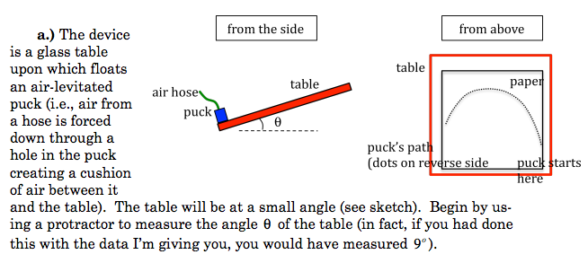
Tilted Table Lab
Today: we’ll take the data. Tomorrow: we’ll look at how to analyze and write this lab up.

Slide 5
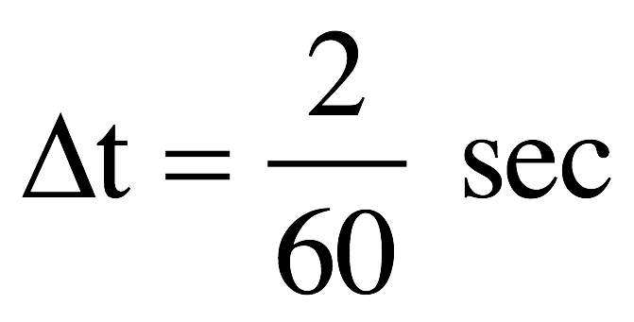
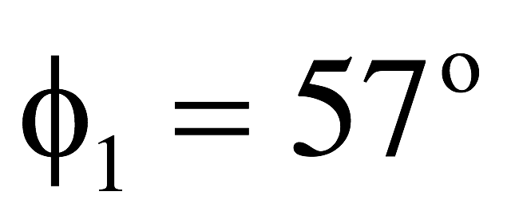
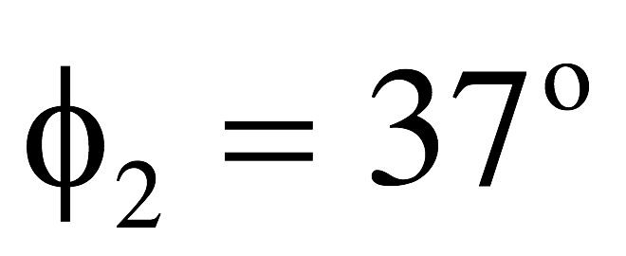
Tilted Table lab – extracting data
Table angle: 6.8º
etc.

Slide 6
Problem 3.23 (modified)
A student throws a baseball off the top of a 50.0 m tall building with an initial speed of 18.0 m/s at an angle of 30.0º below the horizontal.
a) What are the baseball’s initial coordinates?
b) Find the x- and y-components of the initial velocity.
c) Write the velocity equations as a function of time for both the x and y directions.
d) Write the position equations as a function of time for both the x and y directions
Problem 3.29 - how is this different?
A stone is thrown upward from the top of a building at 15 m/s at an angle of 25º above the horizontal. The stone hits the ground below after 3.0 s. How tall is the cliff? How far from the base of the cliff does the stone land?

